Slide 1
INARMJHA OPERATING SYSTEM

Slide 2
INSTALLING LINUX DISTRIBUTION
2. INSTALLING REQUIRED PACKAGES
INSTALLING GNOME DESKTOP ENVIRONMENT
AUTORUN(BACKGROUND PROCESSES)

Slide 3
1.INSTALLING LINUX DISTRIBUTION:
Kernel of the operating System:
Arch Linux Kernel is used
kernel version : 4.9.6-1-ARCH
the linux distribution is installed through command line

Slide 4
2. INSTALLING REQIURED PACKAGES:
AUR(ARCH USER REPOSITORY):
Repository is the storage location from where packages are retrieved for installation.
The packages are accessible through “pacman”
package-name Description
1. firefox for creating a safer,faster and stable
browser
2. numix-icon-theme-git icon theme

Slide 5
3.INSTALLING DESKTOP ENVIRONMENT:
DESKTOP ENVIRONMENT:
Desktop Environment:
GNOME is used.GNOME is a desktop environment that aims to be simple and easy to use.
Version : GNOME Shell 3.22.2
The GTK+ theme used is “vertex-dark”
The icon theme used is ”Numix –circle-light ”.All these are retrieved from AUR and installed using pacman

Slide 6
EXTRACTION OF GNOME SHELL THEME:
First you need to extract the existing “shell-theme” to a folder in the /home directory.
Navigate to the created directory and you should find the theme files.
Now copy your preferred image to this directory.
You can find .css file and .xml file in the gnome-shell theme directory.

Slide 7
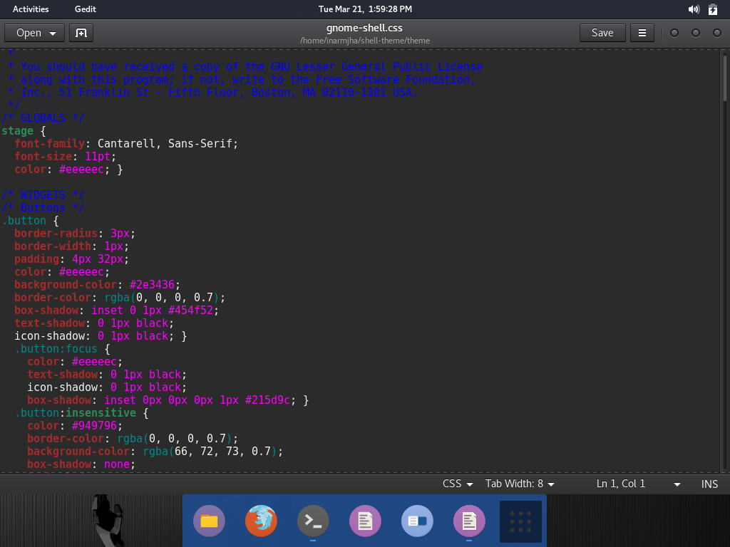
The .css file can be changed according to our reqirements
The .css file path is /home/inarmjha/shell-theme/theme

Slide 8
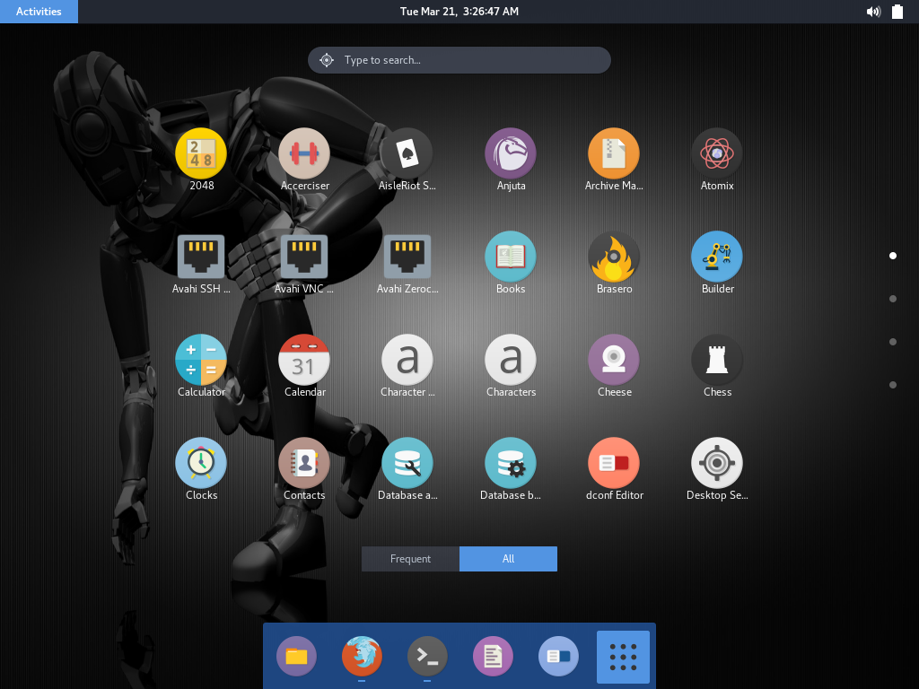
The round icons in the menu

Slide 9
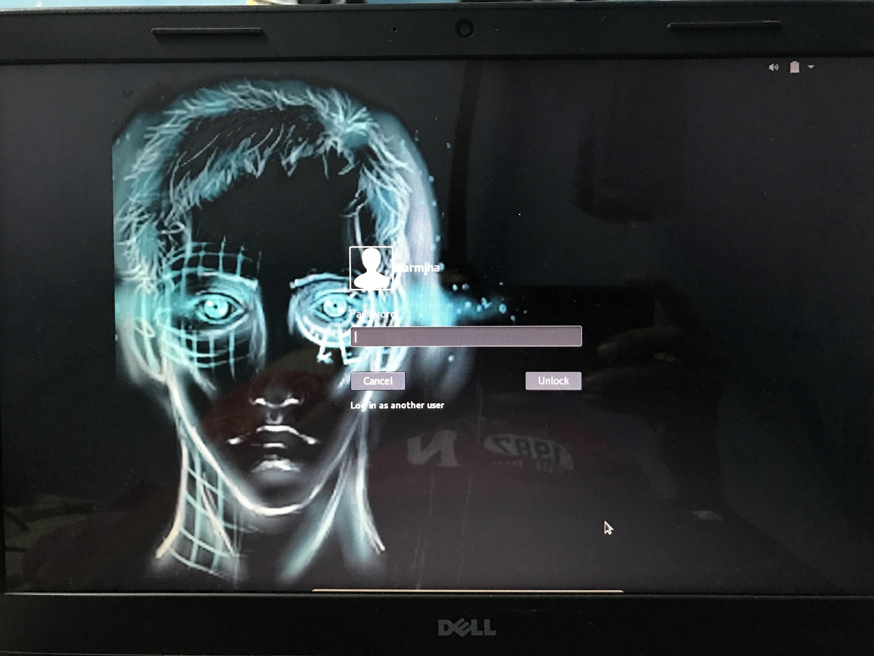
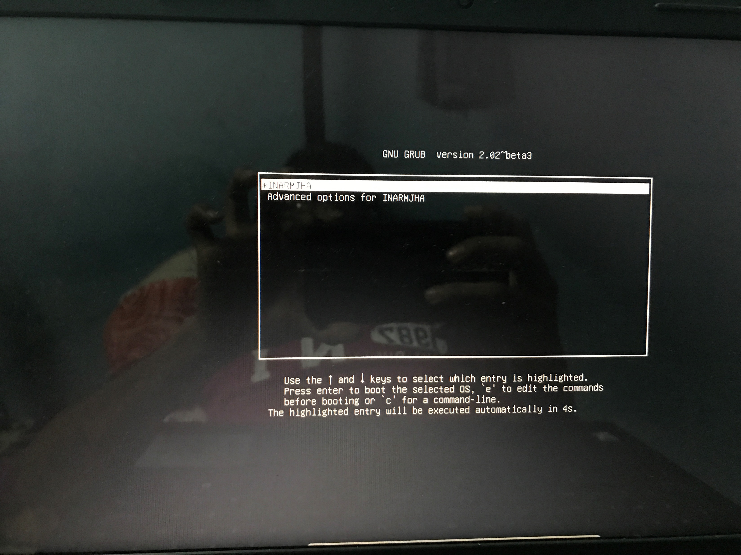
LOGIN PAGE
BOOT TIME

Slide 10
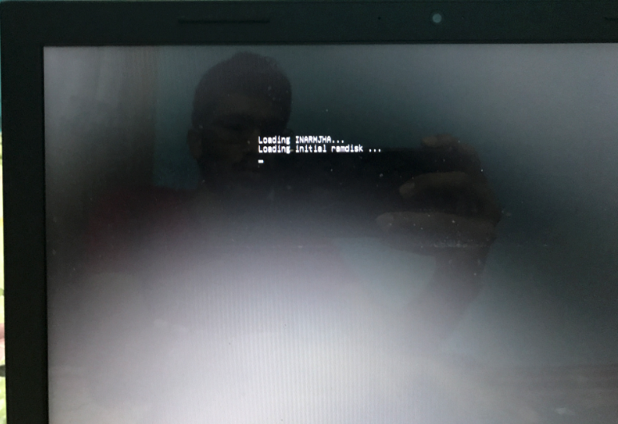
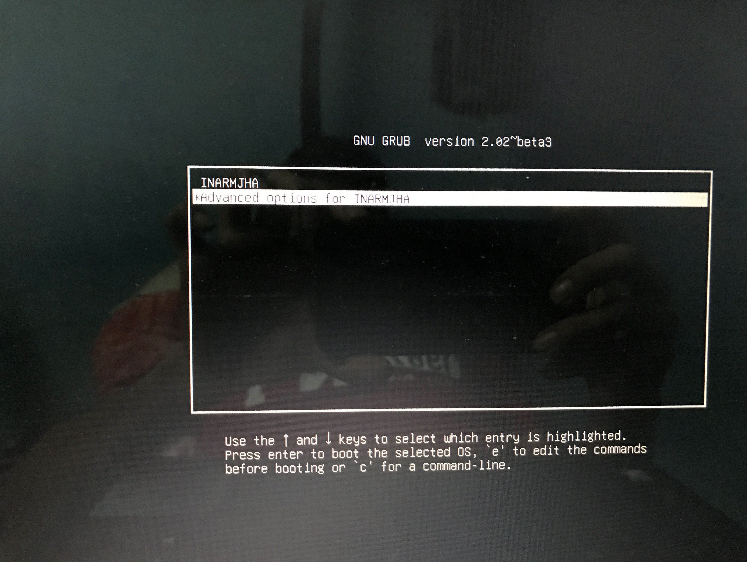
BOOT TIME
BOOT TIME

Slide 11
4. AUTORUN OF BACKGROUND PROCESSES:
AUTOSTARTING :
DAEMONS: The program that runs as back-ground process.
In this OS we run,
Chatter.py, Server.py, Facerecognition.py as background processes.
The background services are written and kept in /lib/systemd/system.
The programs added to these files ,autostart at booting time.

Slide 12
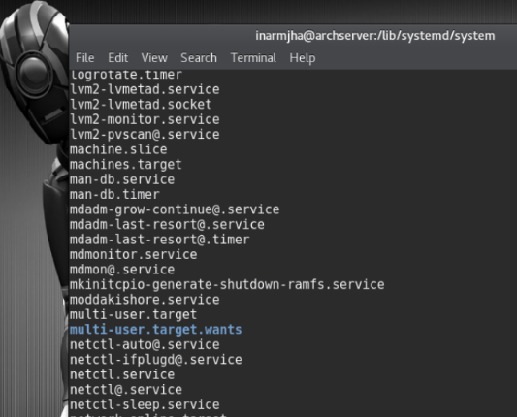
Present path is /lib/systemd/system.
The services that run at boot time or kernel modules are in this directory
Autorun scripts are kept in this system/system directory

